Slide 1

Firewalls
https://education.nationalgeographic.org/resource/great-wall-china/

Slide 2
Agenda
Types of Firewalls
  Host-Based
  Network-Based
  Stateless
  Stateful
Reading Firewall Logs

Slide 3

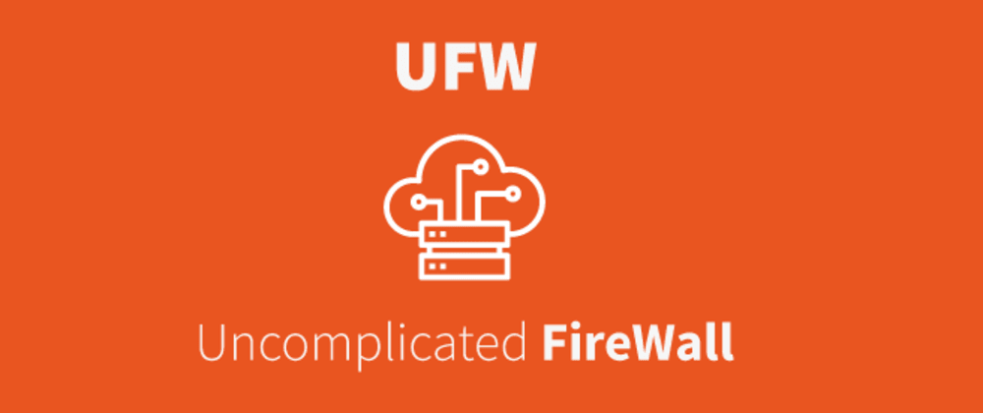
Host-Based Firewall
Last line of defense in the world of Firewalls
Software running on your host machines
Sometimes packaged with OS
  Windows Defender
  iptables / UFW
https://answers.microsoft.com/en-us/windows/forum/all/i-love-windows-defender/3add2f03-5e9f-45a2-95e1-15bd97e2b1d8

Slide 4
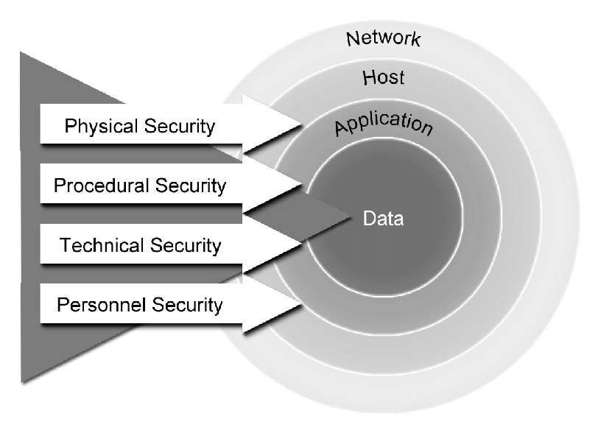
Host-Based Firewall
Controls traffic only on the individual host machine.
Should be considered an additional layer of security to work with Network-Based Firewalls
Security is all about layers
researchgate.net/figure/Classic-IT-Security-Onion_fig2_265675938

Slide 5
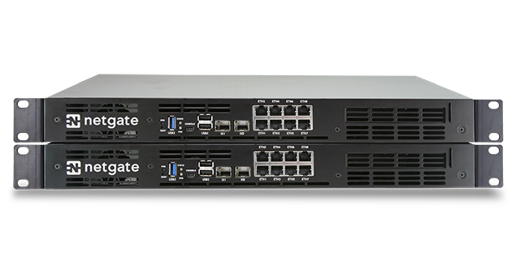


Network-Based Firewalls
Often standalone “boxes” in your server racks. Sometimes referred to as “Hardware Firewalls”
Can get VERY expensive depending on features.
You want to place these at as many points on your network as possible and you want a mix of vendors if possible to support technology diversity
pfsense offers a free version of their firewall server you can download and tinker with!
https://www.pfsense.org/download/
https://www.pfsense.org/

Slide 6
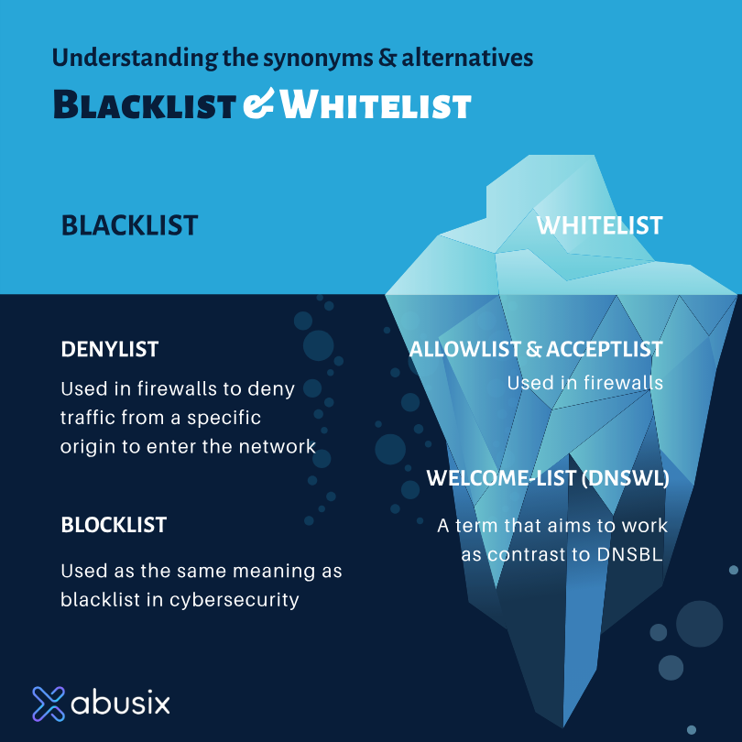
You’re Not on the List
https://abusix.com/resources/blocklists/why-changing-the-terms-blacklist-and-whitelist-isnt-as-easy-as-it-might-seem/

Slide 7

Iceberg Image is NOT real
It’s actually two different icebergs Photoshopped together.
https://www.youtube.com/watch?v=J4WUz7xY3rA

Slide 8
iptables
The default firewall on Linux distributions
Allows for very tight control of network traffic by allowing the user to define rules that determine how packets are handled
Filters packets, Network Address Translation, and packet manipulation
With great control comes great difficulty

Slide 9
UFW
Uncomplicated Firewall
A wrapper for iptables that makes managing them well… Uncomplicated.
Provides a simplified interface for iptables
The best Firewall configuration is the one you actually configure.
UFW is a command-line tool GUFW provides a GUI wrapped for UFW

Slide 10
Stateless Vs Stateful
Stateless
  A stateless firewall uses the stateless protocol, and therefore doesn’t remember any previous state of data packets. Stateless firewalls filters the packet that’s passing through the firewall in real-time according to a rule list, held client-side. Each data communication is effectively in a silo.
Stateful
  Remembers the state of the data that’s passing through the firewall, and can filter according to deeper information than its stateless friend. It will monitor all the parts of a traffic stream, including TCP connection stages, status updates, and previous packet activity.
  After a type of traffic has been approved, it will be added to a kind of database (known as a state table or a connection table) so that the stateful firewall works to make intelligent decisions about these kinds of packets in the future. This type of firewall is also called a dynamic packet filtering firewall, and an example is the Microsoft Defender Firewall, often the default choice for PC users.
https://www.atera.com/blog/stateful-vs-stateless-firewall-whats-the-difference-and-why-does-it-matter/

Slide 11
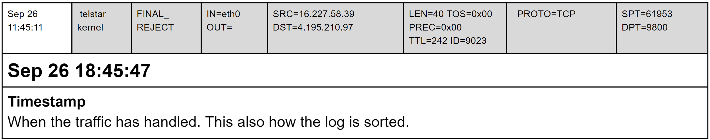

Firewall Logs
Sep 26 18:45:47 telstar kernel: FINAL_REJECT: IN=eth0 OUT= SRC=165.227.158.39 DST=194.195.210.97 LEN=40 TOS=0x00 PREC=0x00 TTL=242 ID=9023 PROTO=TCP SPT=61953 DPT=9800

Slide 12
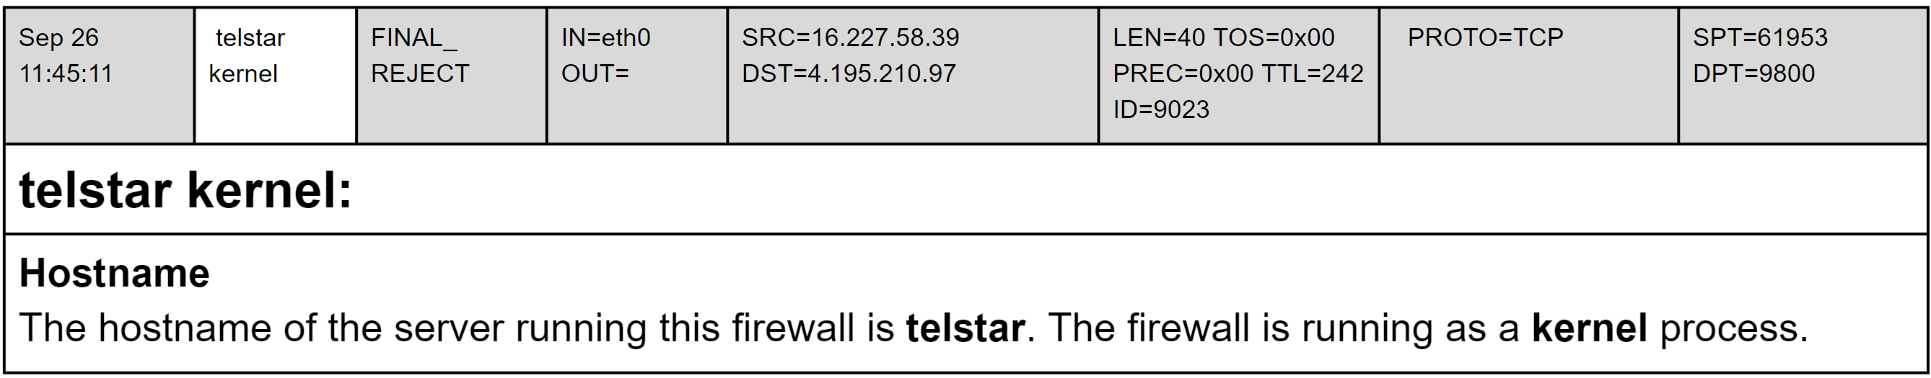
Firewall Logs
Sep 26 18:45:47 telstar kernel: FINAL_REJECT: IN=eth0 OUT= SRC=165.227.158.39 DST=194.195.210.97 LEN=40 TOS=0x00 PREC=0x00 TTL=242 ID=9023 PROTO=TCP SPT=61953 DPT=9800
Netfilter is the Linux kernel level process that is actually running the firewall and is controlled by iptables/UFW

Slide 13
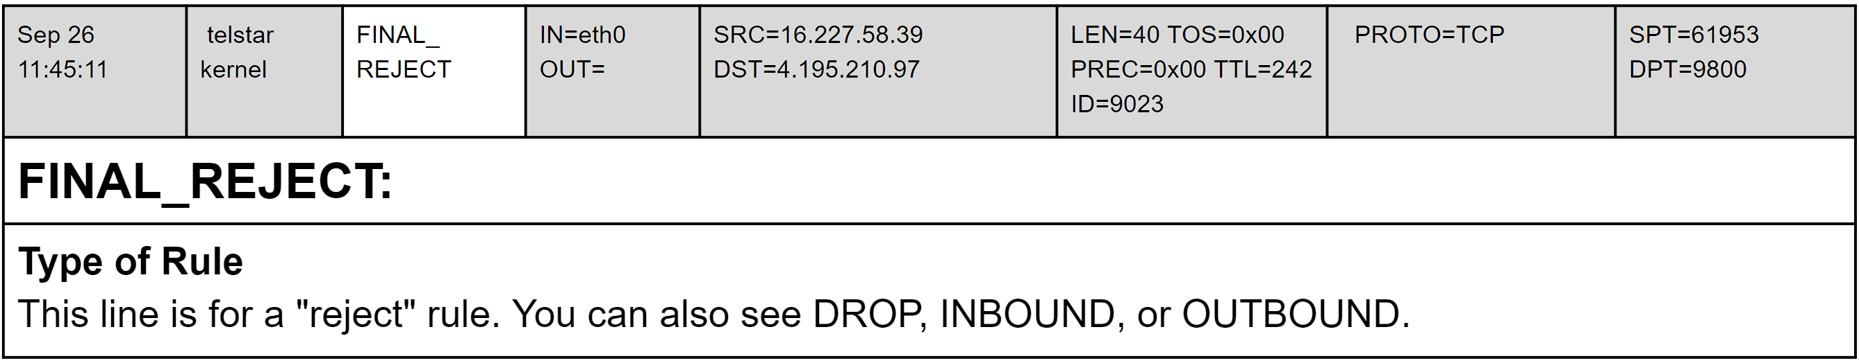
Firewall Logs
Sep 26 18:45:47 telstar kernel: FINAL_REJECT: IN=eth0 OUT= SRC=165.227.158.39 DST=194.195.210.97 LEN=40 TOS=0x00 PREC=0x00 TTL=242 ID=9023 PROTO=TCP SPT=61953 DPT=9800

Slide 14
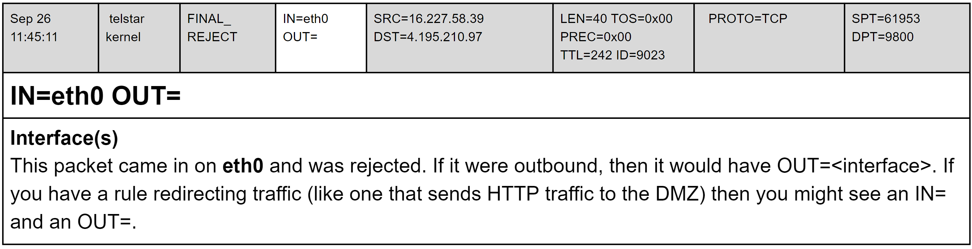
Firewall Logs
Sep 26 18:45:47 telstar kernel: FINAL_REJECT: IN=eth0 OUT= SRC=165.227.158.39 DST=194.195.210.97 LEN=40 TOS=0x00 PREC=0x00 TTL=242 ID=9023 PROTO=TCP SPT=61953 DPT=9800

Slide 15
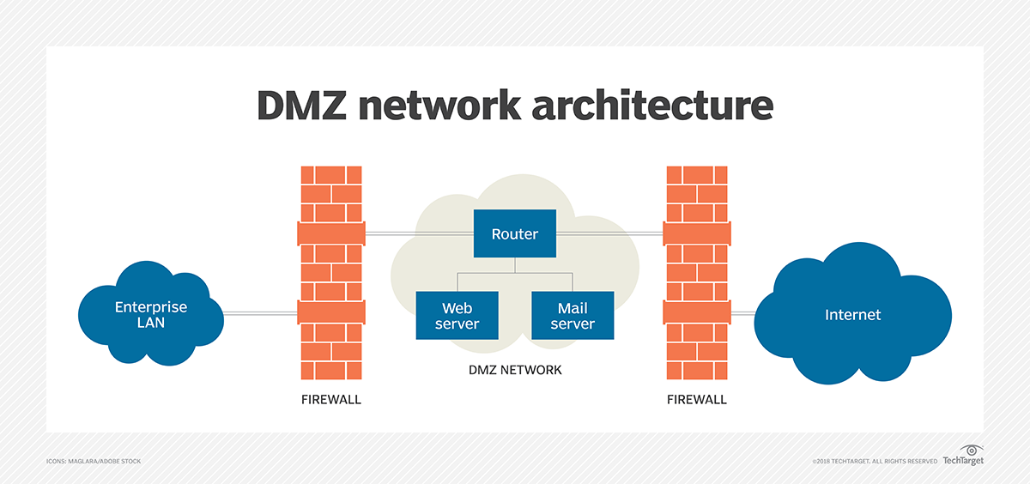
What is the DMZ?!?!
https://www.techtarget.com/searchsecurity/definition/DMZ

Slide 16
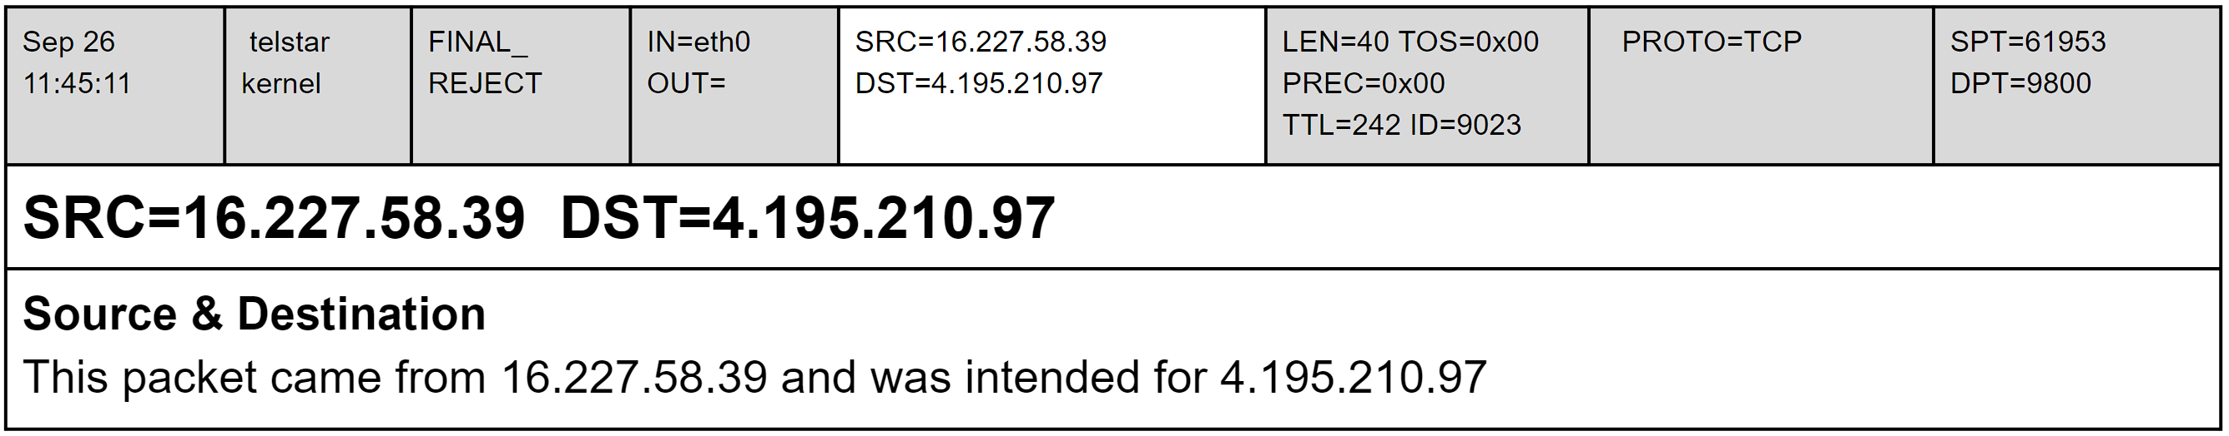
Firewall Logs
Sep 26 18:45:47 telstar kernel: FINAL_REJECT: IN=eth0 OUT= SRC=165.227.158.39 DST=194.195.210.97 LEN=40 TOS=0x00 PREC=0x00 TTL=242 ID=9023 PROTO=TCP SPT=61953 DPT=9800

Slide 17
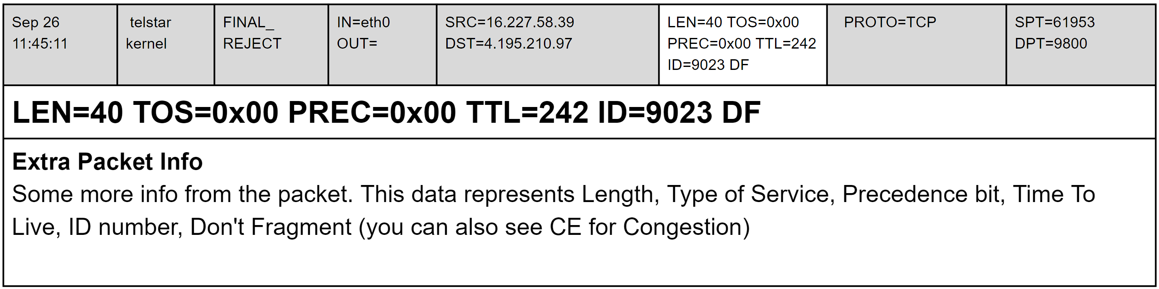
Firewall Logs
Sep 26 18:45:47 telstar kernel: FINAL_REJECT: IN=eth0 OUT= SRC=165.227.158.39 DST=194.195.210.97 LEN=40 TOS=0x00 PREC=0x00 TTL=242 ID=9023 PROTO=TCP SPT=61953 DPT=9800

Slide 18
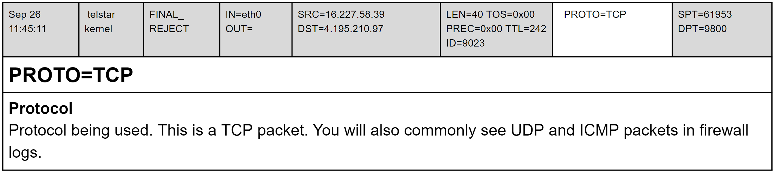
Firewall Logs
Sep 26 18:45:47 telstar kernel: FINAL_REJECT: IN=eth0 OUT= SRC=165.227.158.39 DST=194.195.210.97 LEN=40 TOS=0x00 PREC=0x00 TTL=242 ID=9023 PROTO=TCP SPT=61953 DPT=9800

Slide 19
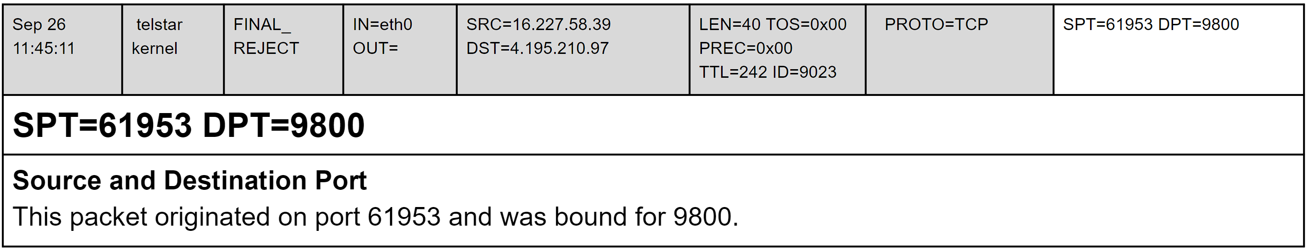
Firewall Logs
Sep 26 18:45:47 telstar kernel: FINAL_REJECT: IN=eth0 OUT= SRC=165.227.158.39 DST=194.195.210.97 LEN=40 TOS=0x00 PREC=0x00 TTL=242 ID=9023 PROTO=TCP SPT=61953 DPT=9800

Slide 20
Helpful CLI Tools for Parsing Logs
grep – Search inside of files or STDIN for a pattern
awk – Useful for formatting and manipulating data
sort – Arrange data from a file in various ways
uniq – Filter only unique lines from a sorted input
wc – Useful for counting words, lines, characters, bytes, etc. from a file of STDIN

